Slide 1

E6895 Advanced Big Data Analytics Task Milestone 1:
Visual Exploration of Large Graph in Immersive Environment
Sam Guleff [SG2665]
February 2nd, 2017

Slide 2
Milestone Goals
Milestone I – Research, Setup & Design
Milestone II – Build Fundamentals and Demo
Milestone III – Advance & Extend Capabilities
Aspirational – External Connections & Advanced Interactions

Slide 3
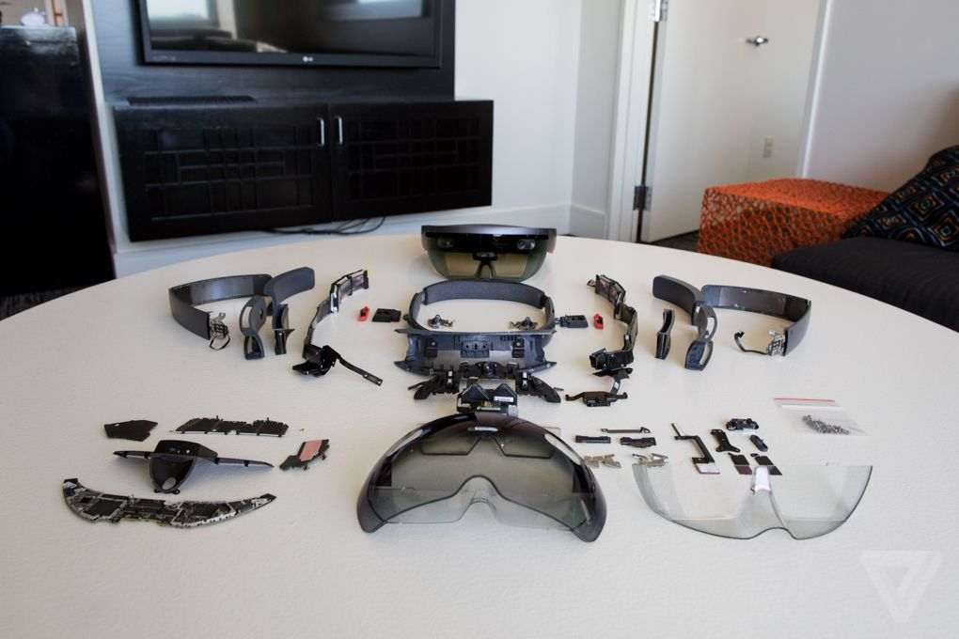
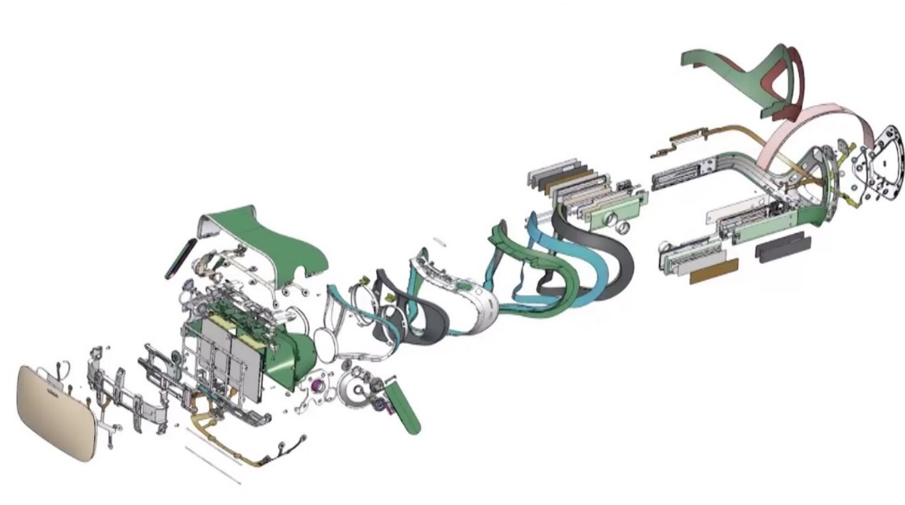
Milestone I – Deliverables What is VR/AR
AR – Augmented Reality
VR – Virtual Reality
Augmented Integrated Reality
Gyroscope/ Optical Motion Tracking
Split Eye Holographic Projection
Spatial Audio Tracking
Location Tracking
Integrated
Independent Reality
Gyroscope Motion Tracking
Split Eye Stereoscopic Vision
Spatial Audio Tracking
Location Tracking
Cabled to Physical PC

Slide 4

Milestone I – Deliverables What is VR/AR

Slide 5
Milestone I – Deliverables What is VR/AR

Slide 6
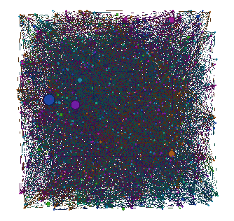
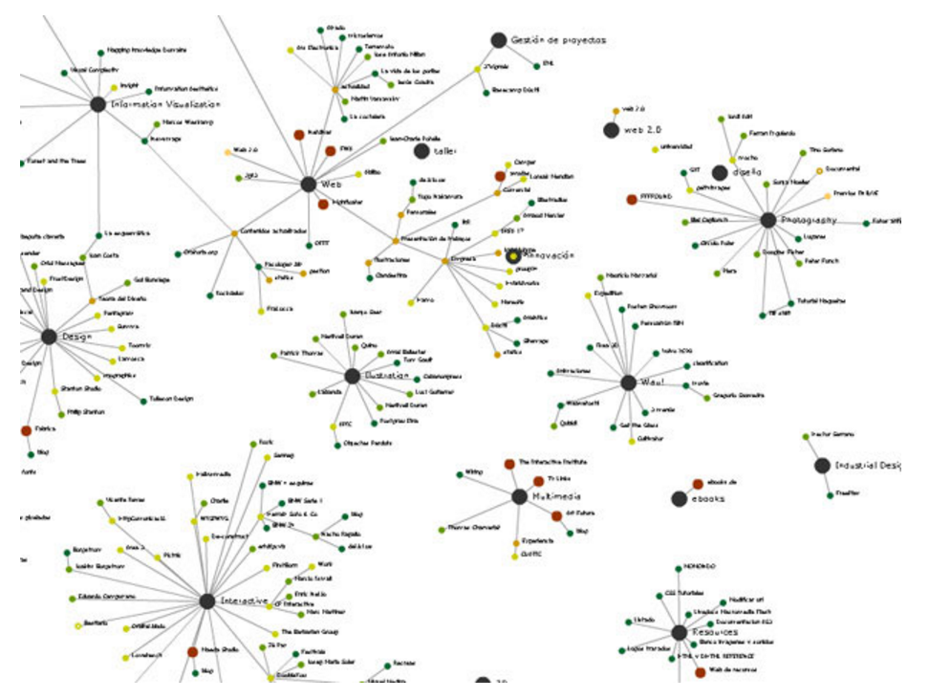
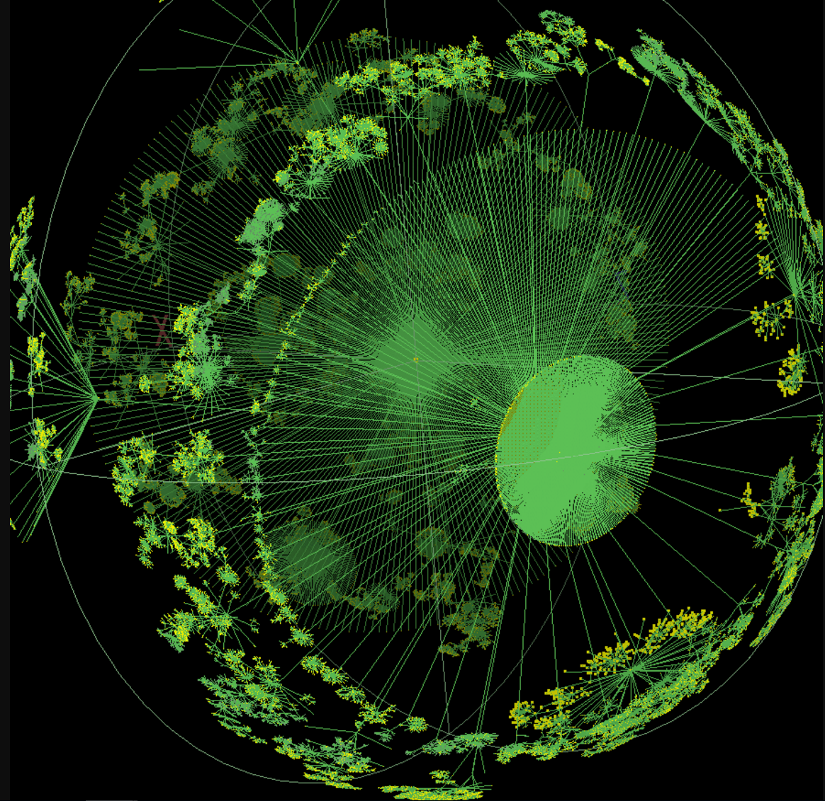
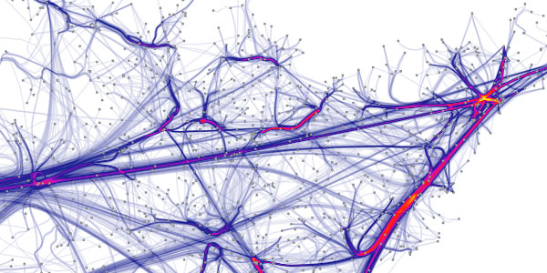
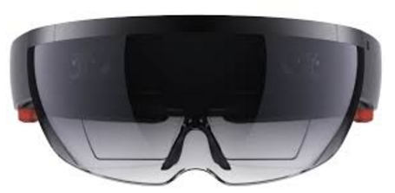
Milestone I – Graph Visualization Today
No Order
Some Spatial Distribution
Interactive Graph
Force Directed
3D
AR/VR

Slide 7
















Milestone I – Use in Industry/Academia
Active Areas of Academic Research
Geospatial Visualizations – Easier interpretability of data
Travel – Augment cities with valuable information
Manufacturing – Cost reductions by removal of templates, foamboards, and masking devices
Architecture- Construction, inspection, renovation
Surgery – Augmented information, skeletal overlay
Auto Safety – Directed driver attention
Construction/Field Workers – Augment underground infrastructure
Art – Augmented Museums and Exhibits
Archeological – Archeological site augmentation
Hololens Partners Actively researching AR

Slide 8
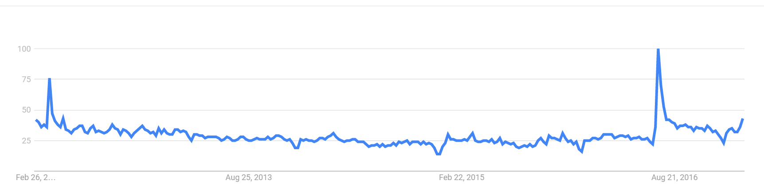
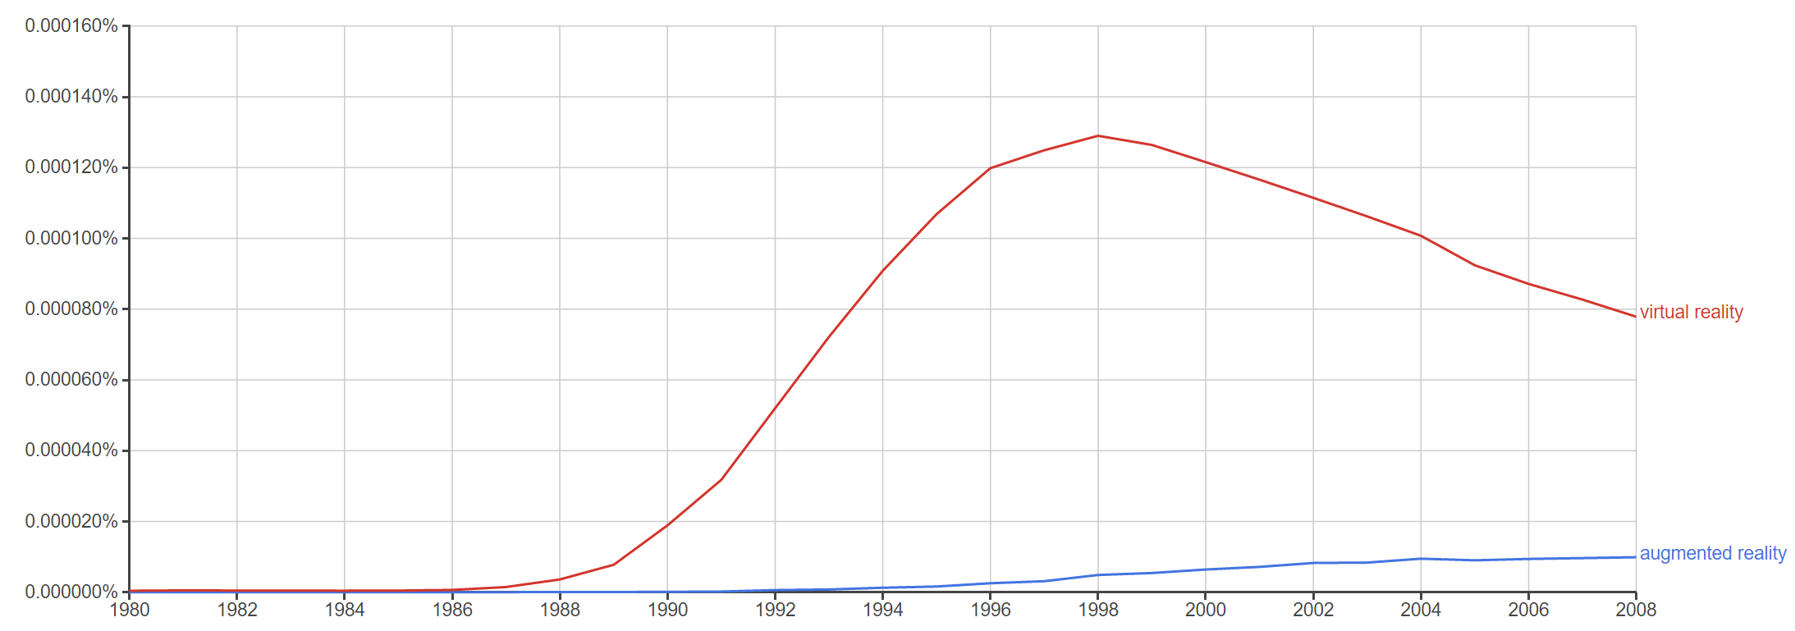
Milestone I – Use in Industry/Academia
AR Search Trends
Google Glasses – Failure Due to Social/Marketing/Cost
Microsoft Hololens -
Magic Leap – 4.5 Billion Dollar Startup
Google Book NGrams

Slide 9
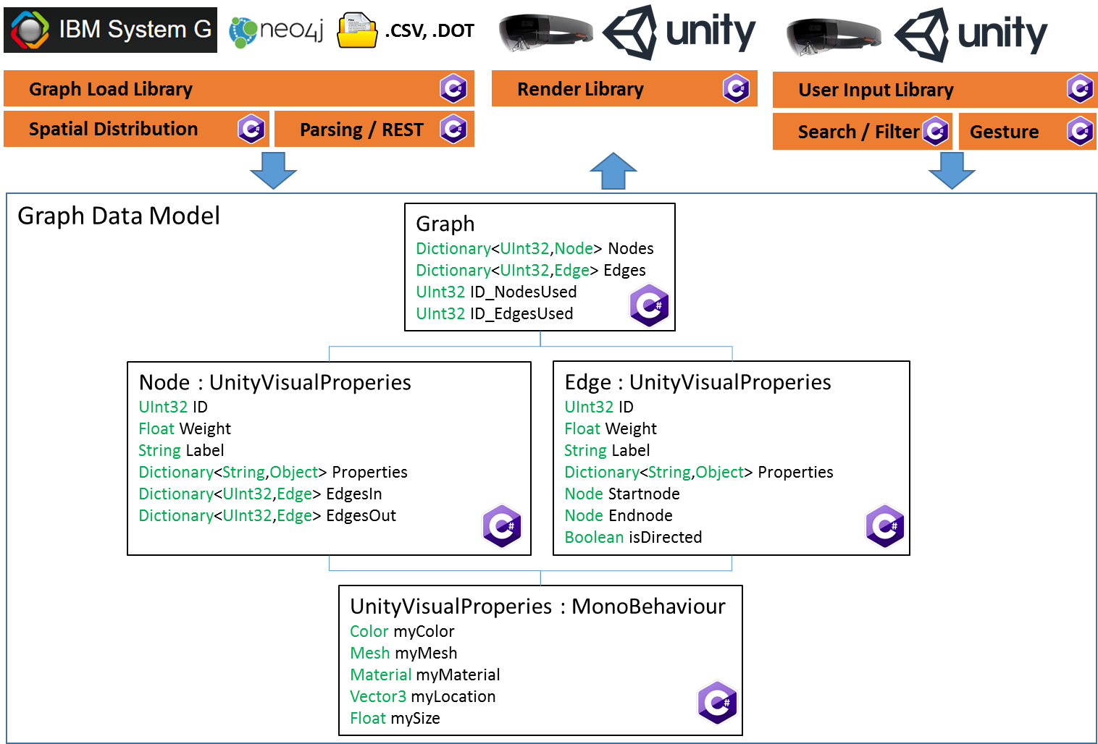
Milestone I – Current Library Architecture

Slide 10

Questions

Slide 11
Milestone I – Appendix
Current State of the Art in AR/VR:
Magic Leap AR: http://www.forbes.com/sites/davidewalt/2016/11/02/inside-magic-leap-the-secretive-4-5-billion-startup-changing-computing-forever/#7a4dcaf2e83f
Hololens Teardown: http://www.theverge.com/2016/4/6/11376442/microsoft-hololens-holograms-parts-teardown-photos-hands-on
Microsoft Hololens: https://www.microsoft.com/microsoft-hololens/en-us
Oculus Rift: https://en.wikipedia.org/wiki/Oculus_Rift
Graphs
Interactive Graphs: https://flowingdata.com/2012/08/02/how-to-make-an-interactive-network-visualization/
Force Directed Graph: http://yifanhu.net/PUB/graph_draw_small.pdf
Walrus 3D Graph Visualization: http://www.caida.org/tools/visualization/walrus/
Graph Drawing: http://graphdrawing.org/index.html
Graph Archive: http://www.graph-archive.org/doku.php
House of Graphs: https://hog.grinvin.org/
TinkerPop: https://tinkerpop.apache.org/

Slide 12
Milestone I – Appendix
Academic Research in AR/VR
Touring Machine: http://link.springer.com/article/10.1007/BF01682023
Manufacturing: http://ieeexplore.ieee.org/abstract/document/183317/
Architecture: http://www.columbia.edu/cu/gsapp/BT/RESEARCH/PAPERS/ar-asce.html
Surgical: http://www.sciencedirect.com/science/article/pii/S0278239197906893
Auto Safety: http://dl.acm.org/citation.cfm?id=1105175
Field Workers: http://link.springer.com/article/10.1007/s00779-008-0204-5
Art: http://dl.acm.org/citation.cfm?id=985060
Geospatial Data: http://www.mitpressjournals.org/doi/abs/10.1162/1054746021470577
Archeological Exploration : http://ieeexplore.ieee.org/abstract/document/1028726/

